Slide 2
Amazon Simple Storage Service (S3)
It is a storage for the internet. It is designed for large-capacity, low-cost storage provision across multiple geographical regions
S3 is Secure because AWS provides:
Encryption to the data that you store. It can happen in two ways:
Client Side Encryption
Server Side Encryption
Multiple copies are maintained to enable regeneration of data in case of data corruption
Versioning, wherein each edit is archived for a potential retrieval.
S3 is Durable because:
It regularly verifies the integrity of data stored using checksums e.g. if S3 detects there is any corruption in data, it is immediately repaired with the help of replicated data.
Even while storing or retrieving data, it checks incoming network traffic for any corrupted data packets.
S3 is Highly Scalable, since
it automatically scales your storage according to your requirement and you only pay for the storage you use.

Slide 3
How much of data one can store in AWS S3 ?
We can store virtually any kind of data, in any format, in S3 and when we talk about capacity, the volume and the number of objects that we can store in S3 are unlimited.
*An object is the fundamental entity in S3. It consists of data, key and metadata.
When we talk about data, it can be of two types-
Data which is to be accessed frequently.
Data which is accessed not that frequently.
Therefore, Amazon came up with 3 storage classes to provide its customers the best experience and at an affordable cost.

Slide 4

3 storage classes with a “health-care” use case
1.Amazon S3 Standard for frequent data access
2. Amazon S3 Standard for infrequent data access
3. Amazon Glacier

Slide 5

1.Amazon S3 Standard for frequent data access
This is suitable for performance sensitive use cases where the latency should be kept low. e.g. in a hospital, frequently accessed data will be the data of admitted patients, which should be retrieved quickly

Slide 6
2. Amazon S3 Standard for infrequent data access
This is suitable for use cases where the data is long lived and less frequently accessed, i.e for data archival but still expects high performance.
e.g. in the same hospital, people who have been discharged, their records/data will not be needed on a daily basis, but if they return with any complication, their discharge summary should be retrieved quickly.

Slide 7

3. Amazon Glacier
Suitable for use cases where the data is to be archived, and high performance is not required, it has a lower cost than the other two services.
e.g. in the hospital, patients’ test reports, prescriptions, MRI, X Ray, Scan docs etc. that are older than a year will not be needed in the daily run and even if it is required, lower latency is not needed

Slide 8
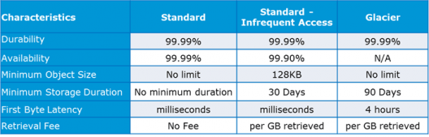
Specification Snapshot: Storage Classes

Slide 9
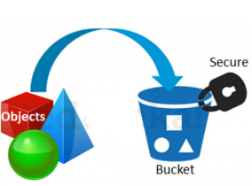
How is data organized in S3?
Data in S3 is organized in the form of buckets.
A Bucket is a logical unit of storage in S3.
A Bucket contains objects which contain the data and metadata.
Before adding any data in S3 the user has to create a bucket which will be used to store objects.

Slide 10
Where is your data stored geographically?
You can self-choose where or in which region your data should be stored. Making a decision for the region is important and therefore it should be planned well.
These are the 4 parameters to choose the optimal region –
Pricing
User/Customer Location
Latency
Service Availability

Slide 11
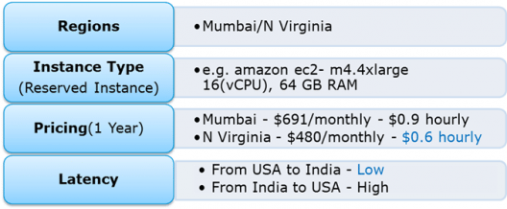
Use case : launch storage instances to host a website for the customers in the US and India.

Slide 12
Selection N Virginia
Now looking at the above parameters, we can clearly identify, that N Virginia will be the best region for this company because of the low latency and low price.
Irrespective of your location, you can select any region which might suit your requirements, since you can access your S3 buckets from anywhere.
Talking about regions, let’s see about the possibility of having a backup in some other availability region or you may want to move your data to some other region.
Thankfully, this feature has been recently added to the AWS S3 system and is pretty easy to use.

Slide 13
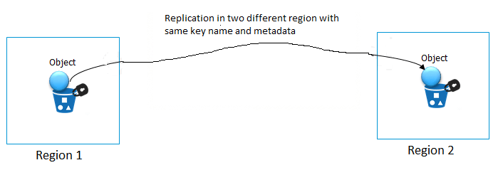
Cross-region Replication
As the name suggests, Cross-region Replication enables user to either replicate or transfer data to some other location without any hassle.

Slide 14
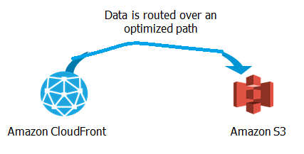
How is the data transferred?
Besides traditional transfer practices that is over the internet, AWS has 2 more ways to provide data transfer securely and at a faster rate:
Transfer Acceleration
Snowball

Slide 15
Transfer Acceleration
Transfer enables fast, easy and secure transfers over long distances by exploiting Amazon’s CloudFront edge technology.
CloudFront is a caching service by AWS, in which the data from client site gets transferred to the nearest edge location and from there the data is routed to your AWS S3 bucket over an optimised network path.

Slide 16

Snowball
The Snowball is a way of transferring your data physically.
In this Amazon sends an equipment to your premises, on which you can load the data.
It has a kindle attached to it which has your shipping address when it is shipped from Amazon. When data transfer is complete on the Snowball
kindle changes the shipping address back to the AWS headquarters where the Snowball has to be sent.
The Snowball is ideal for customers who have large batches of data move. The average turnaround time for Snowball is 5-7 days, in the same time Transfer Acceleration can transfer up to 75 TB of data on a dedicated 1Gbps line. So depending on the use case, a customer can decide.

Slide 17
Pricing
Isn’t anything free on AWS?”
Yes! As a part of the AWS Free Usage Tier, you can get started with AWS S3 for free. Upon sign up, new AWS customers receive 5 GB of Amazon S3 standard storage, 20,000 Get-Requests, 2,000 Put-Requests, and 15GB of data transfer-out each month for one year.
Over this limit, there is a cost attached, let’s understand how amazon charges you

Slide 18
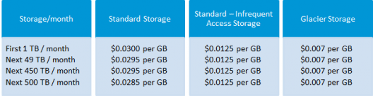
S3 Billing

Slide 19
AWS S3 Use case: 1
Industry “Media”
Let’s understand it through a real time use case to assimilate all what we have learnt so far: IMDb Internet Movie Database is a famous online database of information related to films, television programs and video games.
Let’s see how they exploit the AWS services:
To get the lowest possible latency, all possible results for a search are pre-calculated with a document for every combination of letters in search. Each document is pushed to Amazon Simple Storage Service (S3) and thereby to Amazon CloudFront, putting the documents physically close to the users. The theoretical number of possible searches to calculate is mind-boggling—a 20-character search has 23 x 1030 combinations
But in practice, using IMDb’s authority on movie and celebrity data can reduce the search space to about 150,000 documents, which Amazon S3 and Amazon CloudFront can distribute in just a few hours.

Slide 20
AWS S3 Use case: 2
Project Statement – Hosting a Static Website on Amazon S3
Let’s first understand: What is a static website?
In short, it’s a website comprised of only HTML, CSS, and/or JavaScript. That means server-side scripts aren’t supported, so if you want to host a Rails or PHP app, you’ll need to look elsewhere.
For simpler purposes, welcome to the wonderful world of hosting websites on AWS S3!

